Slide 1

Mini Project 2: Airline Passenger Satisfaction Prediction
Nicole Perez
August 24, 2024

Slide 2

Business Problem
An airline company wants to improve its customer service and overall passenger experience.
By understanding the factors that influence customer satisfaction, the company can make data-driven decisions to enhance its services and increase customer loyalty

Slide 3

Data Science Problem
Develop a machine learning model to predict customer satisfaction based on various features such as:
flight experience
service quality
demographic information
This will help the company identify areas for improvement and implement strategies to enhance customer satisfaction.

Slide 4

Dataset: Airline Passenger Satisfaction (source: Kaggle)
contains information about airline passengers, including their demographic details, flight experience, and satisfaction ratings.
It is commonly used for classification tasks to predict customer satisfaction.

Slide 5

It is necessary to predict which of the two levels of satisfaction with the airline the passenger belongs to: ( Target Variable )
Satisfaction
Neutral or dissatisfied

Slide 6
Dataset contains:
Gender: Gender of the passengers (Female, Male)
Customer Type: The customer type (Loyal customer, disloyal customer)
Age: The actual age of the passengers
Type of Travel: Purpose of the flight of the passengers (Personal Travel, Business Travel)
Class: Travel class in the plane of the passengers (Business, Eco, Eco Plus)
Flight distance: The flight distance of this journey
Inflight wifi service: Satisfaction level of the inflight wifi service (0:Not Applicable;1-5)
Departure/Arrival time convenient: Satisfaction level of Departure/Arrival time convenient
Ease of Online booking: Satisfaction level of online booking
Gate location: Satisfaction level of Gate location
Food and drink: Satisfaction level of Food and drink

Slide 7
Dataset contains:
Online boarding: Satisfaction level of online boarding
Seat comfort: Satisfaction level of Seat comfort
Inflight entertainment: Satisfaction level of inflight entertainment
On-board service: Satisfaction level of On-board service
Leg room service: Satisfaction level of Leg room service
Baggage handling: Satisfaction level of baggage handling
Check-in service: Satisfaction level of Check-in service
Inflight service: Satisfaction level of inflight service
Cleanliness: Satisfaction level of Cleanliness
Departure Delay in Minutes: Minutes delayed when departure
Arrival Delay in Minutes: Minutes delayed when Arrival
Satisfaction: Airline satisfaction level(Satisfaction, neutral or dissatisfaction)

Slide 8


Data Preprocessing: - Clean the data - Handle missing values - Encode categorical variables Exploratory Data Analysis (EDA): Analyse the data to understand the distribution of features and identify patterns related to customer satisfaction.

Slide 9
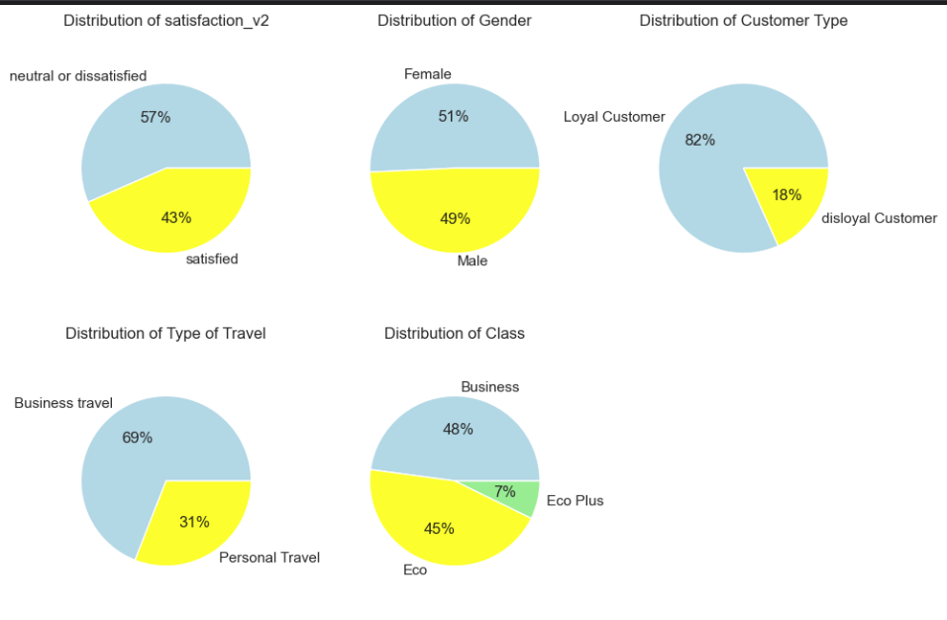
Distribution of Categorical Features

Slide 10
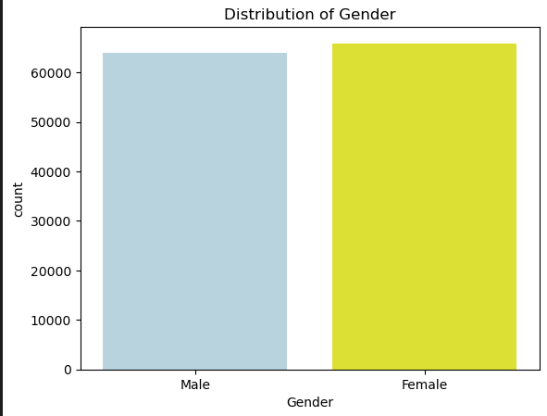
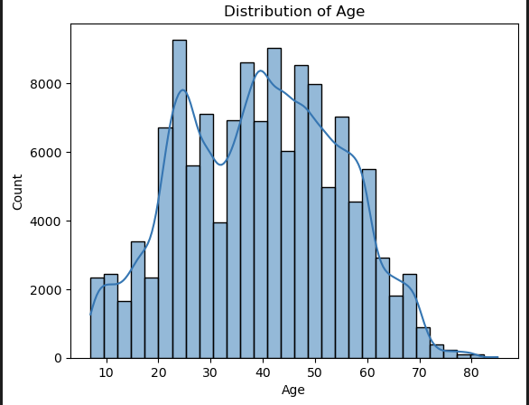
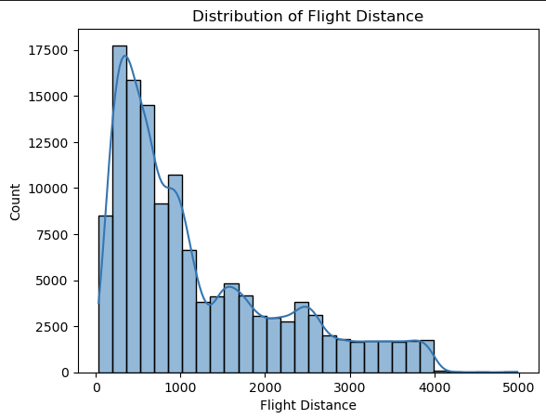
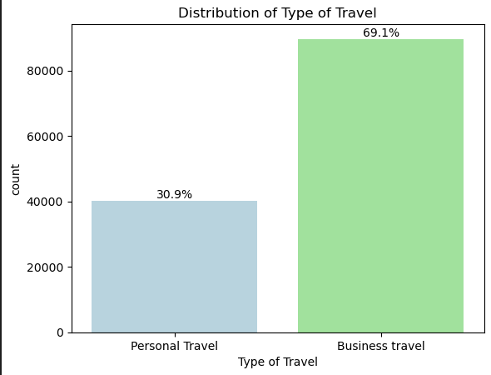
Distribution of Features

Slide 11
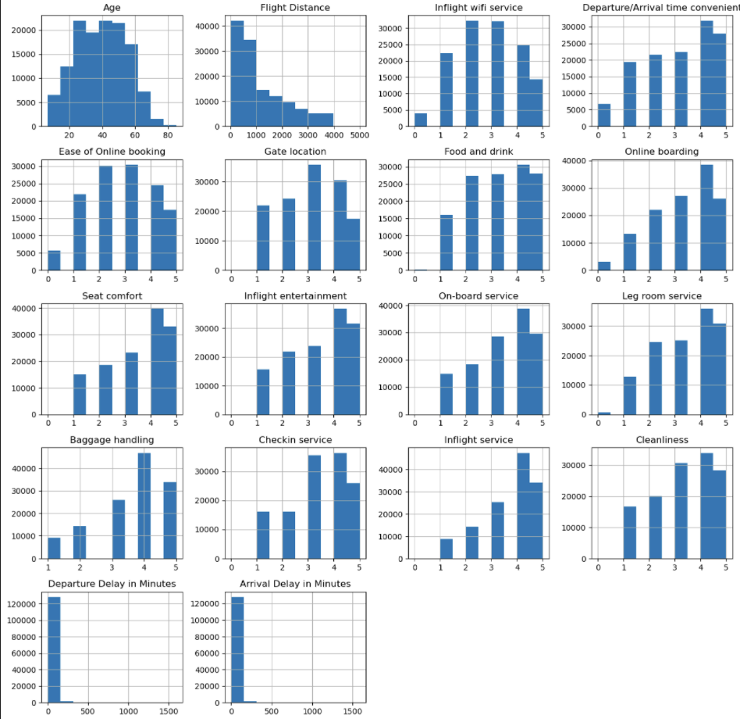
Distribution of Numerical Features

Slide 12
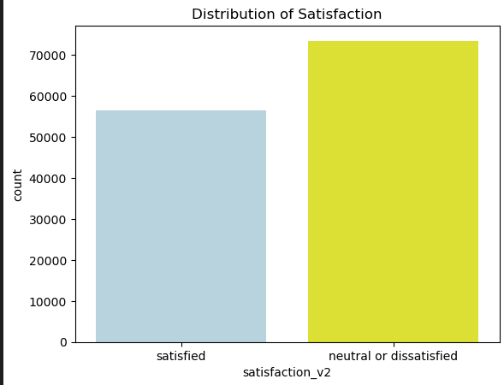
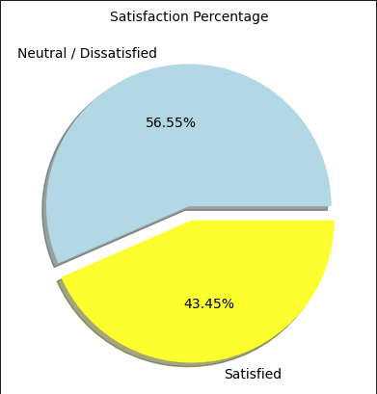
Distribution of Satisfaction
Conclusion:
1) Approximately 56.55% of surveyed passengers expressed neutral or dissatisfied sentiments, while the remaining 43.45 % conveyed satisfaction with the airline.
2) The dataset exhibits no class imbalance (less), as it demonstrates a balanced distribution across both categories: satisfied and neutral/dissatisfied.

Slide 13
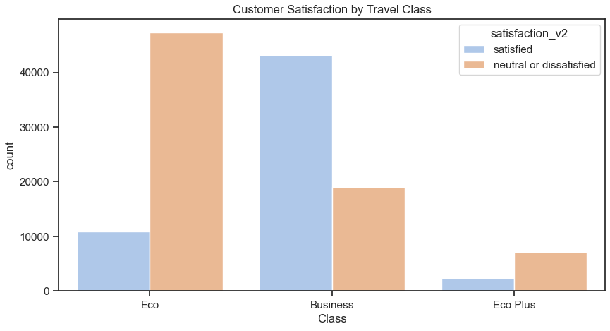
Distribution of Satisfaction
Conclusion based on Customer Satisfaction and Type of Travel class:
The plot shows customer satisfaction by type of travel class. It illustrates how customer satisfaction changes between each travel class, with Business Class having the highest satisfaction and Eco Class having the highest dissatisfaction

Slide 14
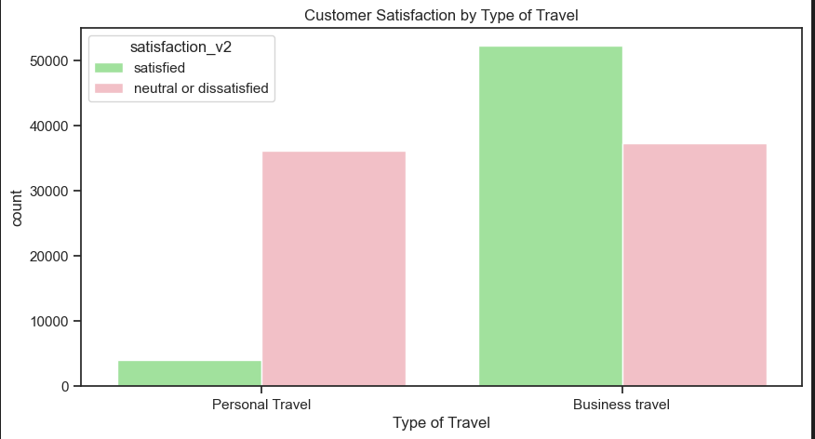
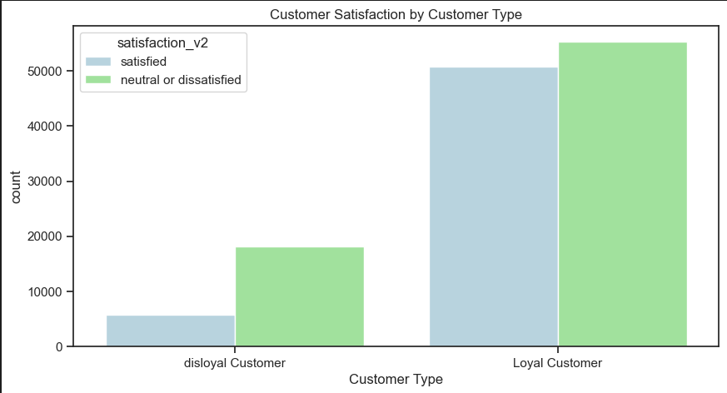
Distribution of Satisfaction

Slide 15
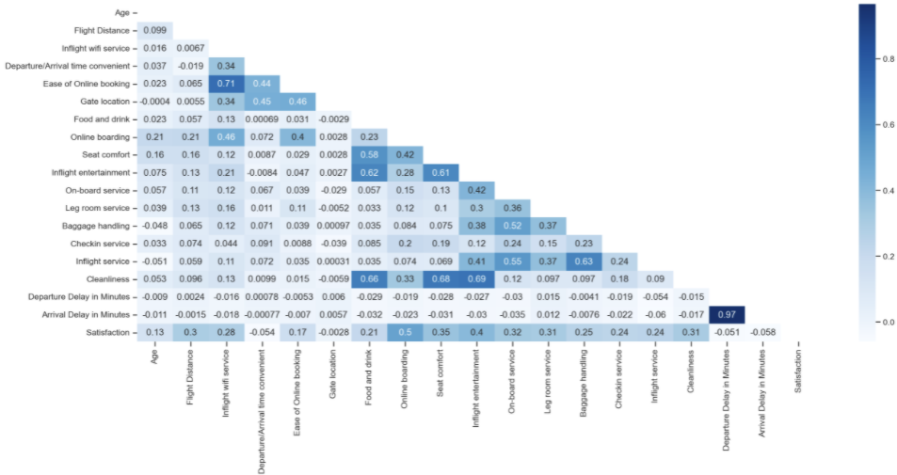
Correlation Matrix
Conclusion based on HeatMap:
A strong positive correlation between arrival delay and departure delay in the heatmap as expected, means that there is a systematic relationship between these two variables.
A correlation coefficient (r) of 0.72 between the ratings of ease of online booking and inflight wifi service indicates a strong positive linear relationship between these two variables. In other words, passengers who find online booking easy are more likely to give higher ratings to inflight wifi service, and vice versa.
Overall, there are not many categories that show a significantly strong relationship with each other or with total satisfaction, it suggests that the variables in dataset may not exhibit strong linear associations.

Slide 16
#Feature Engineering
# Model Selection and Training
# Model Evaluation

Slide 17
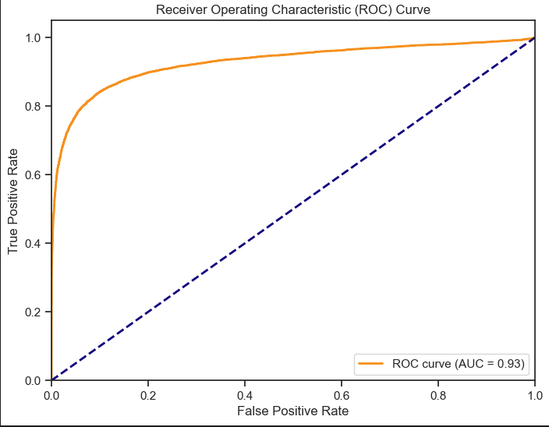
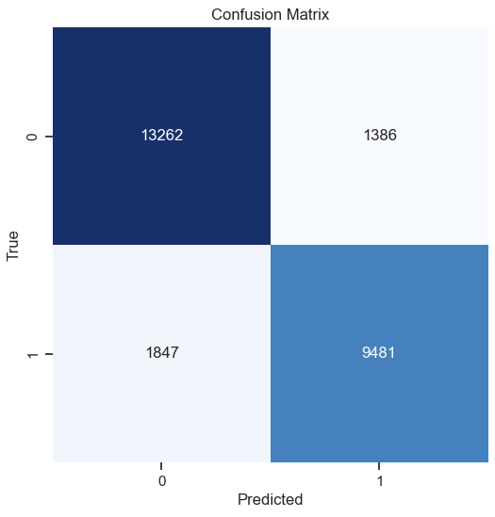
Logistic Regression Model
Accuracy = 0.875538959039113
Precision: 0.8724579000644151
Recall: 0.8369526836158192
F1 Score: 0.8543365622888038
Accuracy = 0.875538959039113
ROC Area under Curve = 0.871166128809548
precision recall f1-score support
0 0.87775 0.90538 0.89135 14648
1 0.87246 0.83695 0.85434 11328
accuracy 0.87554 25976
macro avg 0.87511 0.87117 0.87284 25976
weighted avg 0.87544 0.87554 0.87521 25976

Slide 18
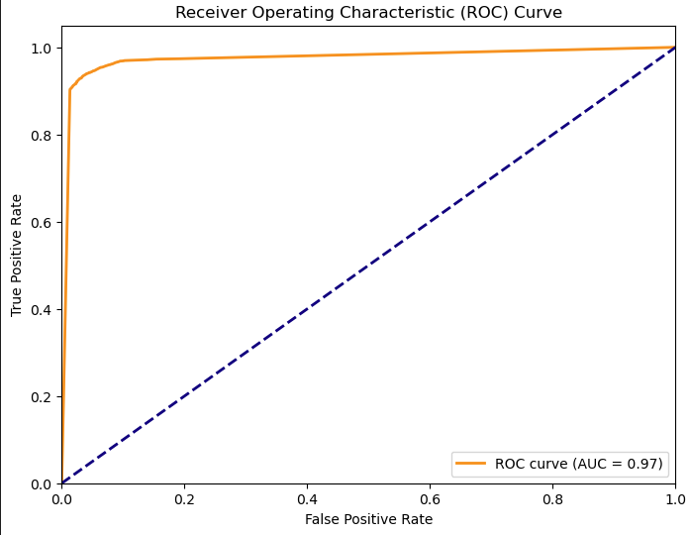
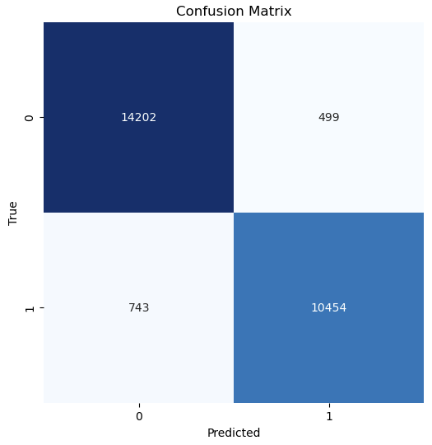
Decision Tree Model
Accuracy = 0.9520426287744227
Precision: 0.9544417054688213
Recall: 0.9336429400732339
F1 Score: 0.9439277652370203
Accuracy = 0.9520426287744227
ROC Area under Curve = 0.9498498354539354
precision recall f1-score support
0 0.95028 0.96606 0.95811 14701
1 0.95444 0.93364 0.94393 11197
accuracy 0.95204 25898
macro avg 0.95236 0.94985 0.95102 25898
weighted avg 0.95208 0.95204 0.95198 25898

Slide 19
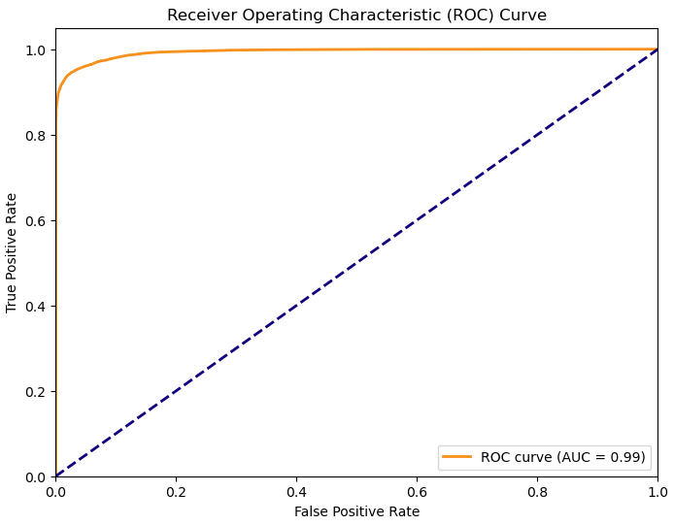
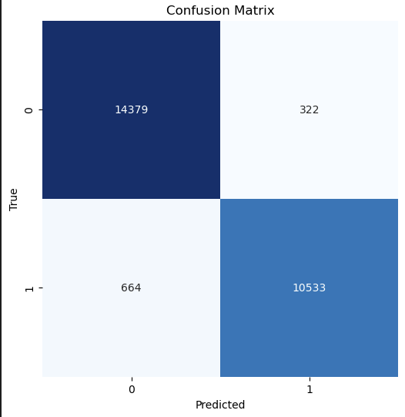
Random Forest Model
Accuracy = 0.9520426287744227
Precision: 0.9544417054688213
Recall: 0.9336429400732339
F1 Score: 0.9439277652370203
Accuracy = 0.9520426287744227
ROC Area under Curve = 0.9498498354539354
precision recall f1-score support
0 0.95028 0.96606 0.95811 14701
1 0.95444 0.93364 0.94393 11197
accuracy 0.95204 25898
macro avg 0.95236 0.94985 0.95102 25898
weighted avg 0.95208 0.95204 0.95198 25898

Slide 20
Model Comparison
 | Model | Accuracy | Precision | Recall | F1 Score | ROC AUC
2 | Random Forest | 0.961928 | 0.970336 | 0.940698 | 0.955288 | 0.993586
1 | Decision Tree | 0.952043 | 0.954442 | 0.933643 | 0.943928 | 0.974762
0 | Logistic Regression | 0.874122 | 0.8688785 | 0.834956 | 0.851535 | 0.926749
Summary:
1) Random Forest stands out as the top-performing model with the highest accuracy and well-balanced precision and recall.
2) Decision Tree is also a great model with high accuracy and balanced precision and recall.
3) Logistic Regression have lowest accuracy compared to the other models.

